Slide 1
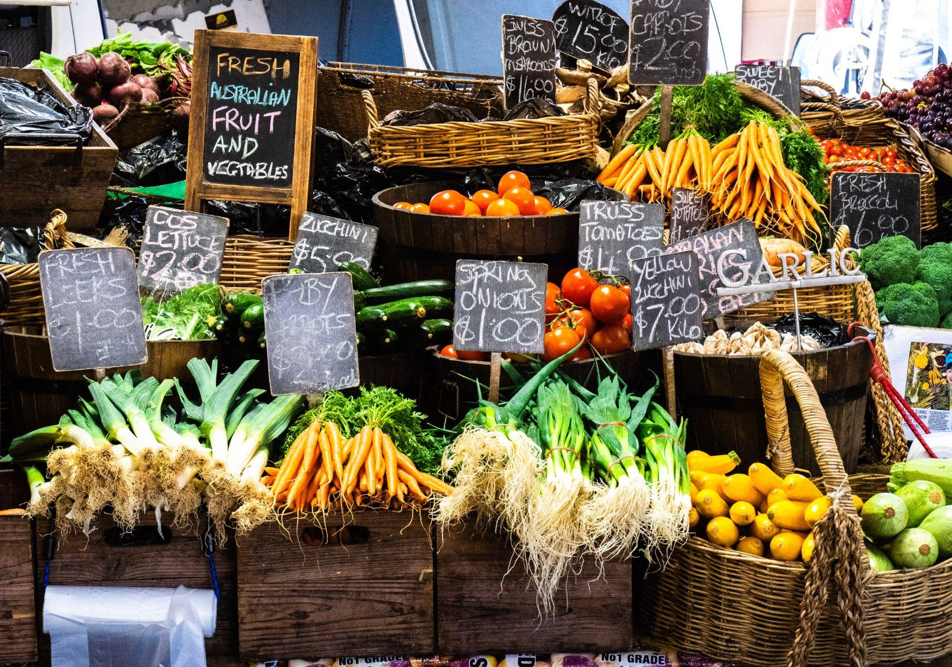
FARM TO TABLE
AISLE
BRING THE FARMERS’ MARKET
TO THE GROCERY STORE
A Data Science Proposal
to Local Grocery Store
to stock from FARMER MARKETS

Slide 2
01
BACKGROUND

Slide 3
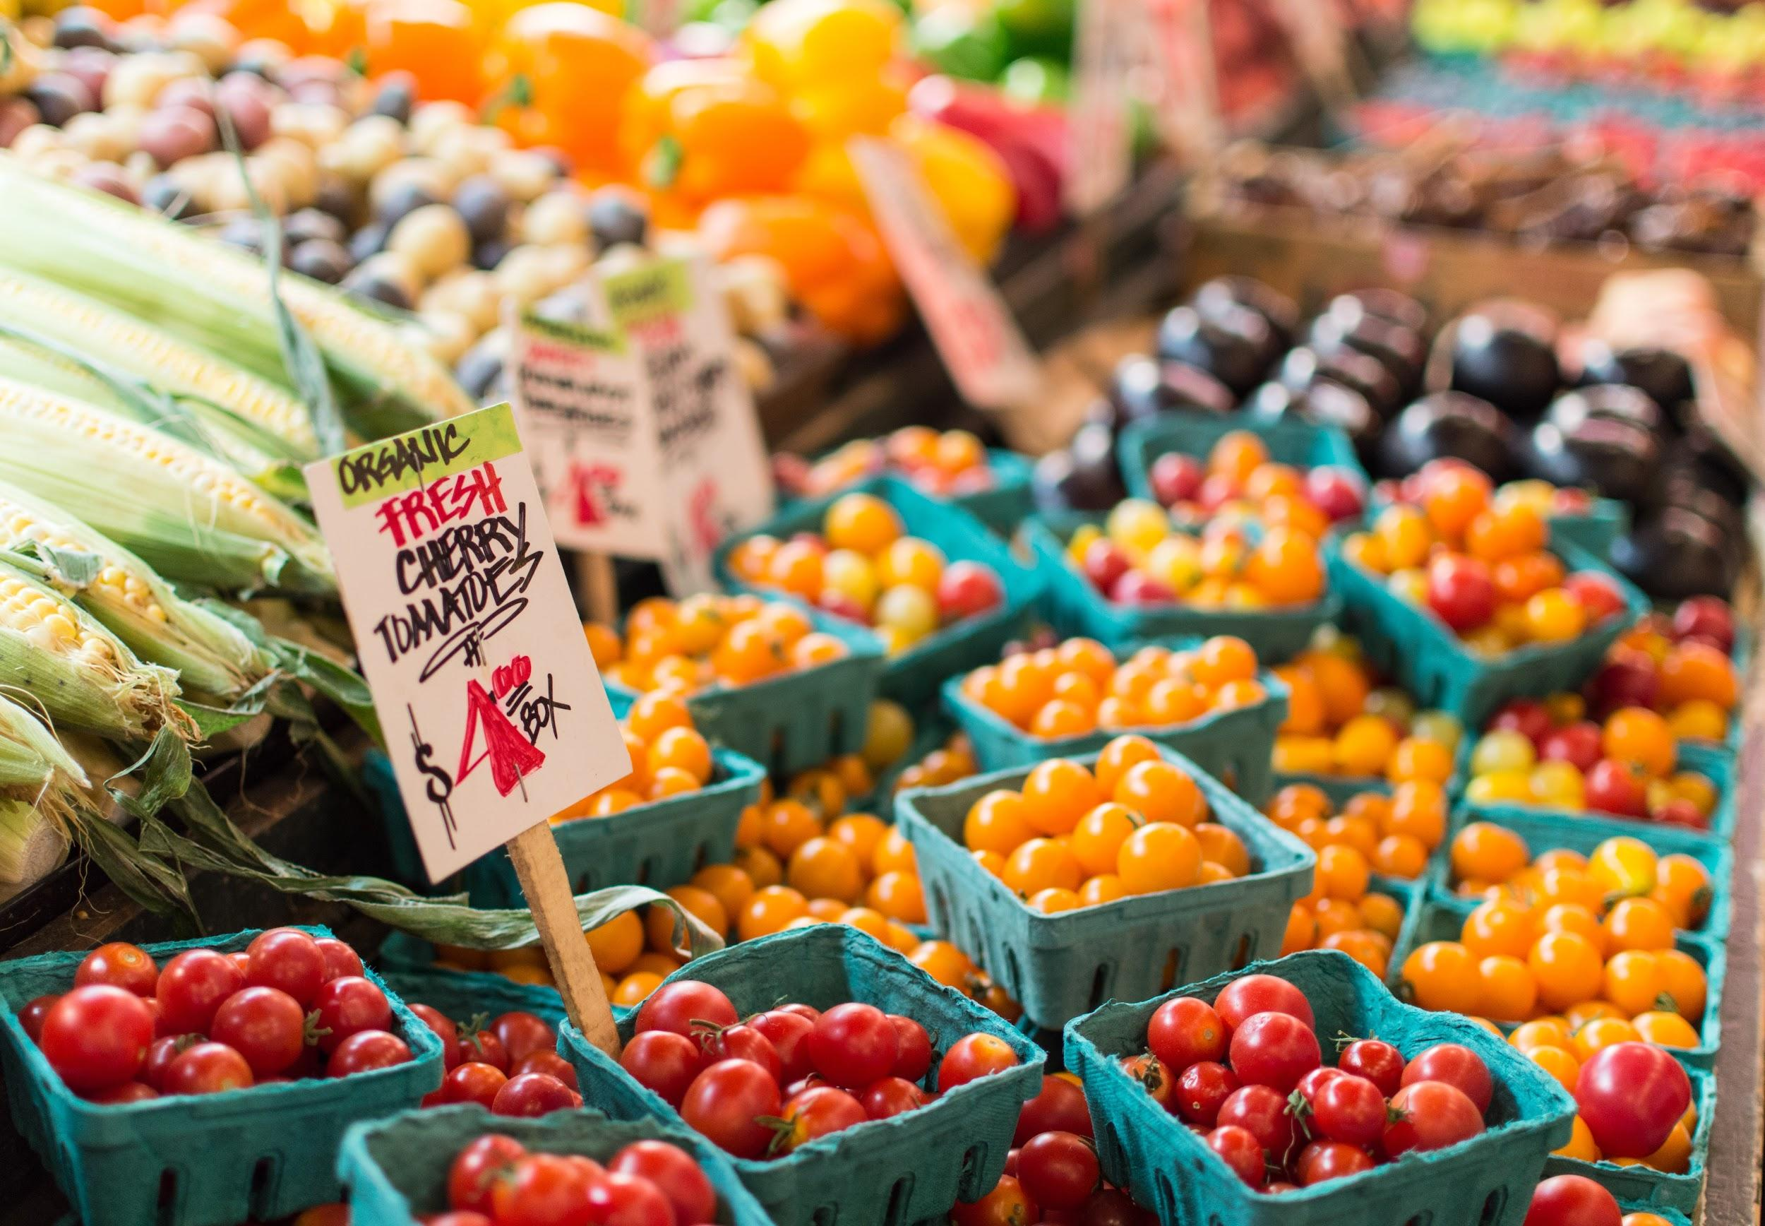
143 / 8804
USDA Farmers’ Markets Data
New York City All the country

Slide 4
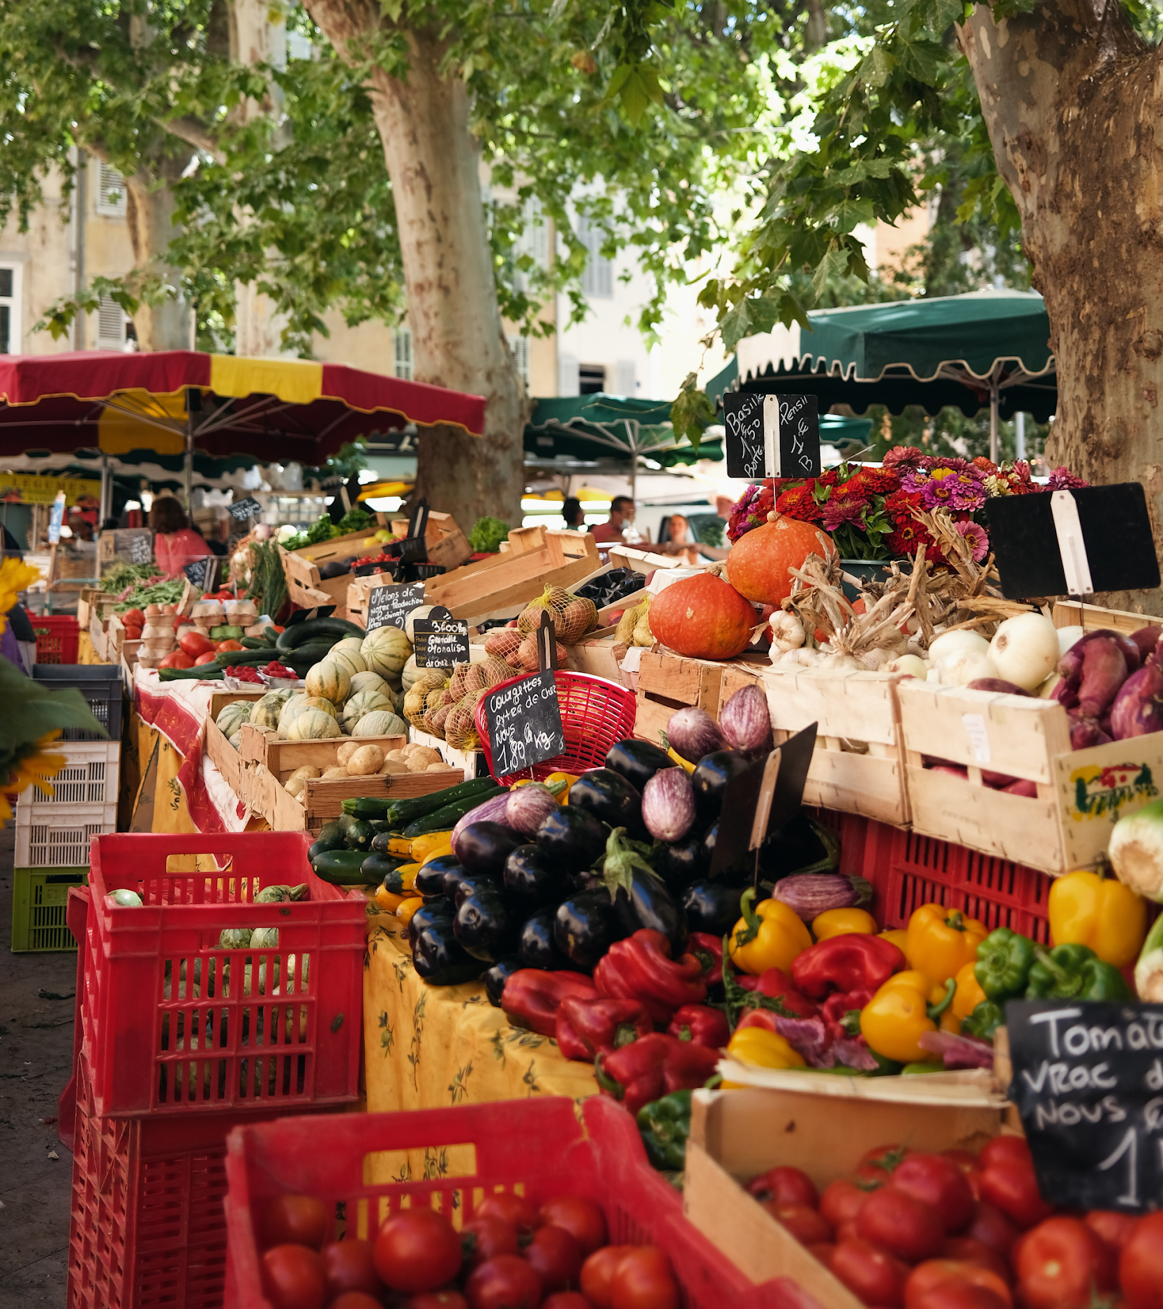
PROBLEM
Lack of continuous access to FMs (DAY OF WEEK)
Lack of variety of local produce (CATEGORIES)

Slide 5
Goal
01
02
03
04
Why
When
What
Where
Make available fresh & local food
All the time -simulate FMs
Variety of produce -from FMs
Stock -from closest FMs

Slide 6
02
OUR SOLUTION

Slide 7
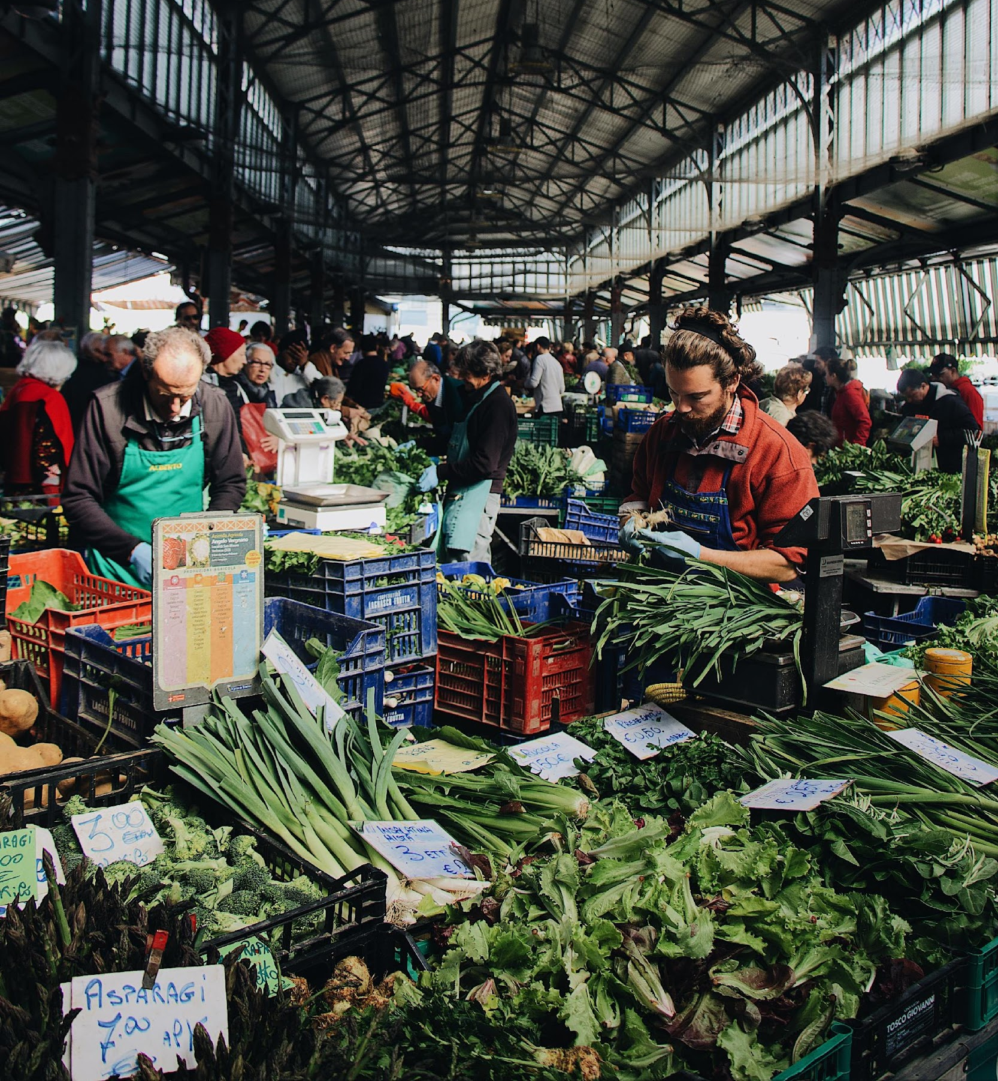
Data Science Solution
Given a specific Grocery Store
Identify the closest FMs WHERE
Each day of the week WHEN
Supplying highest variety WHAT

Slide 8
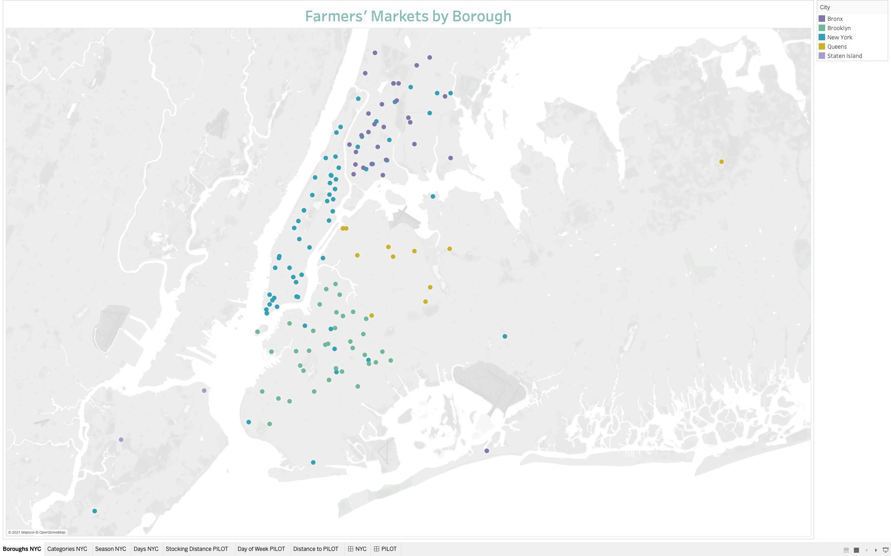
Farmers’
Markets
by Borough

Slide 9
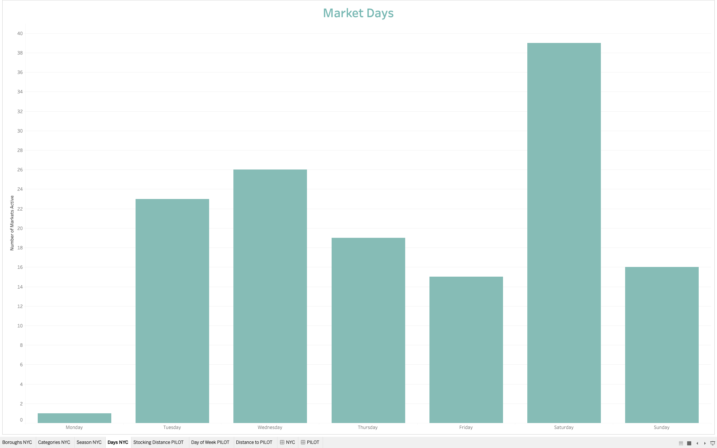
Market Days

Slide 10
03
PILOT PROGRAM

Slide 11
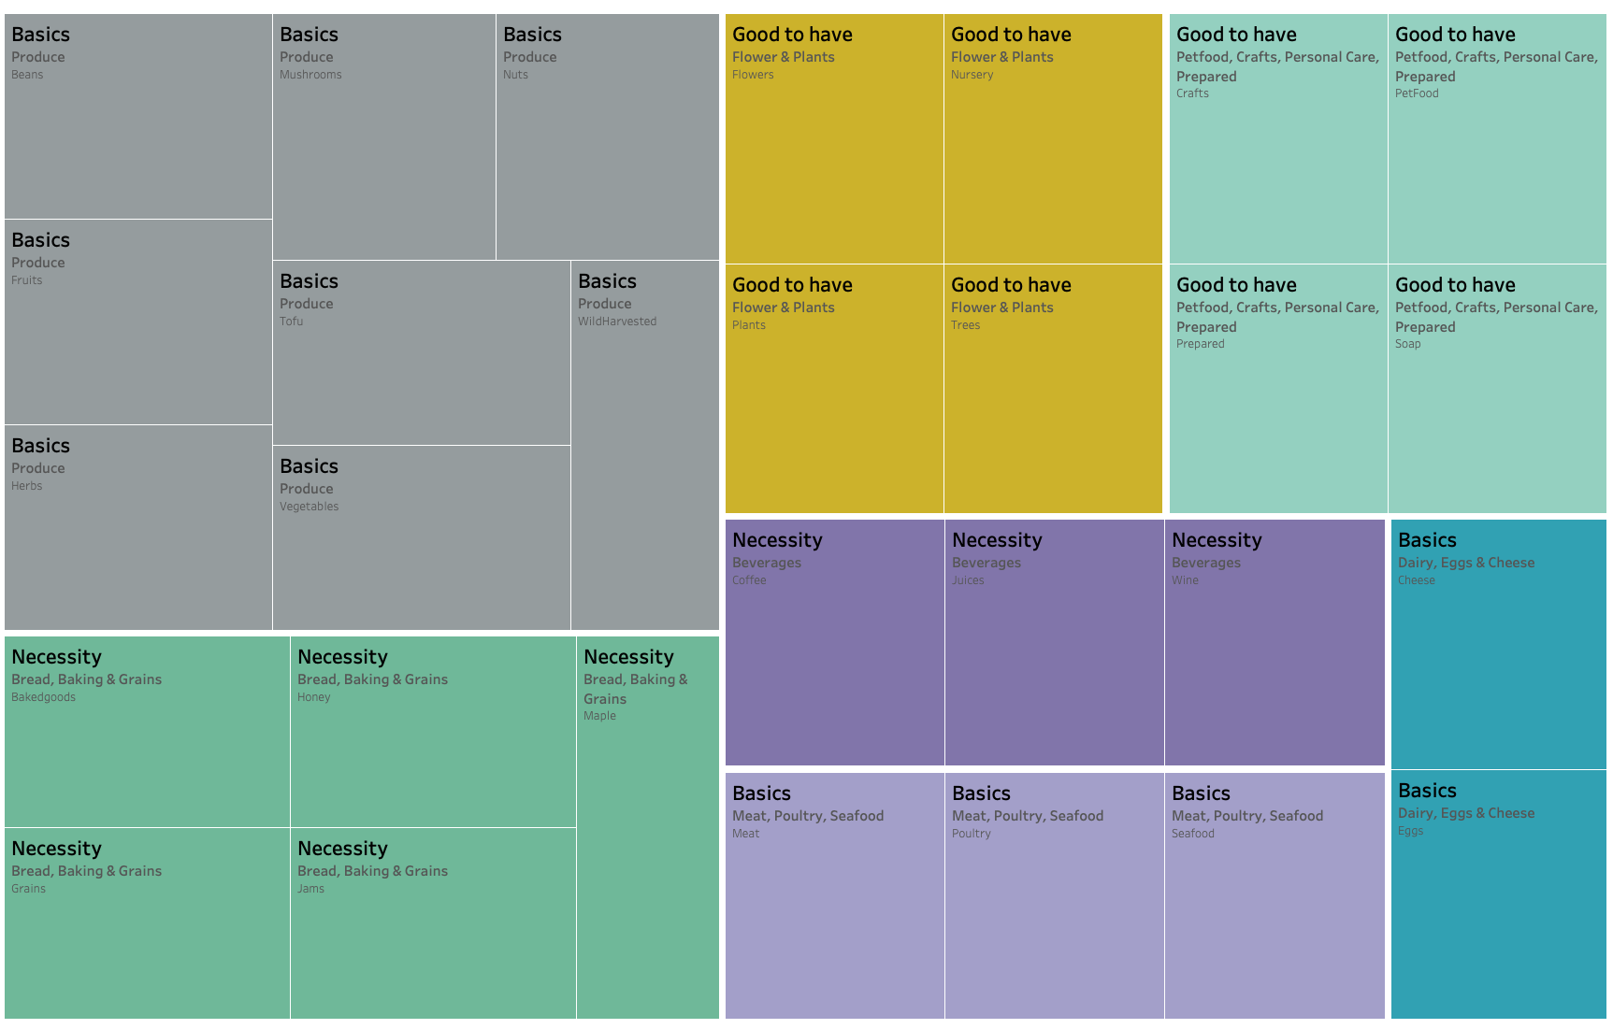
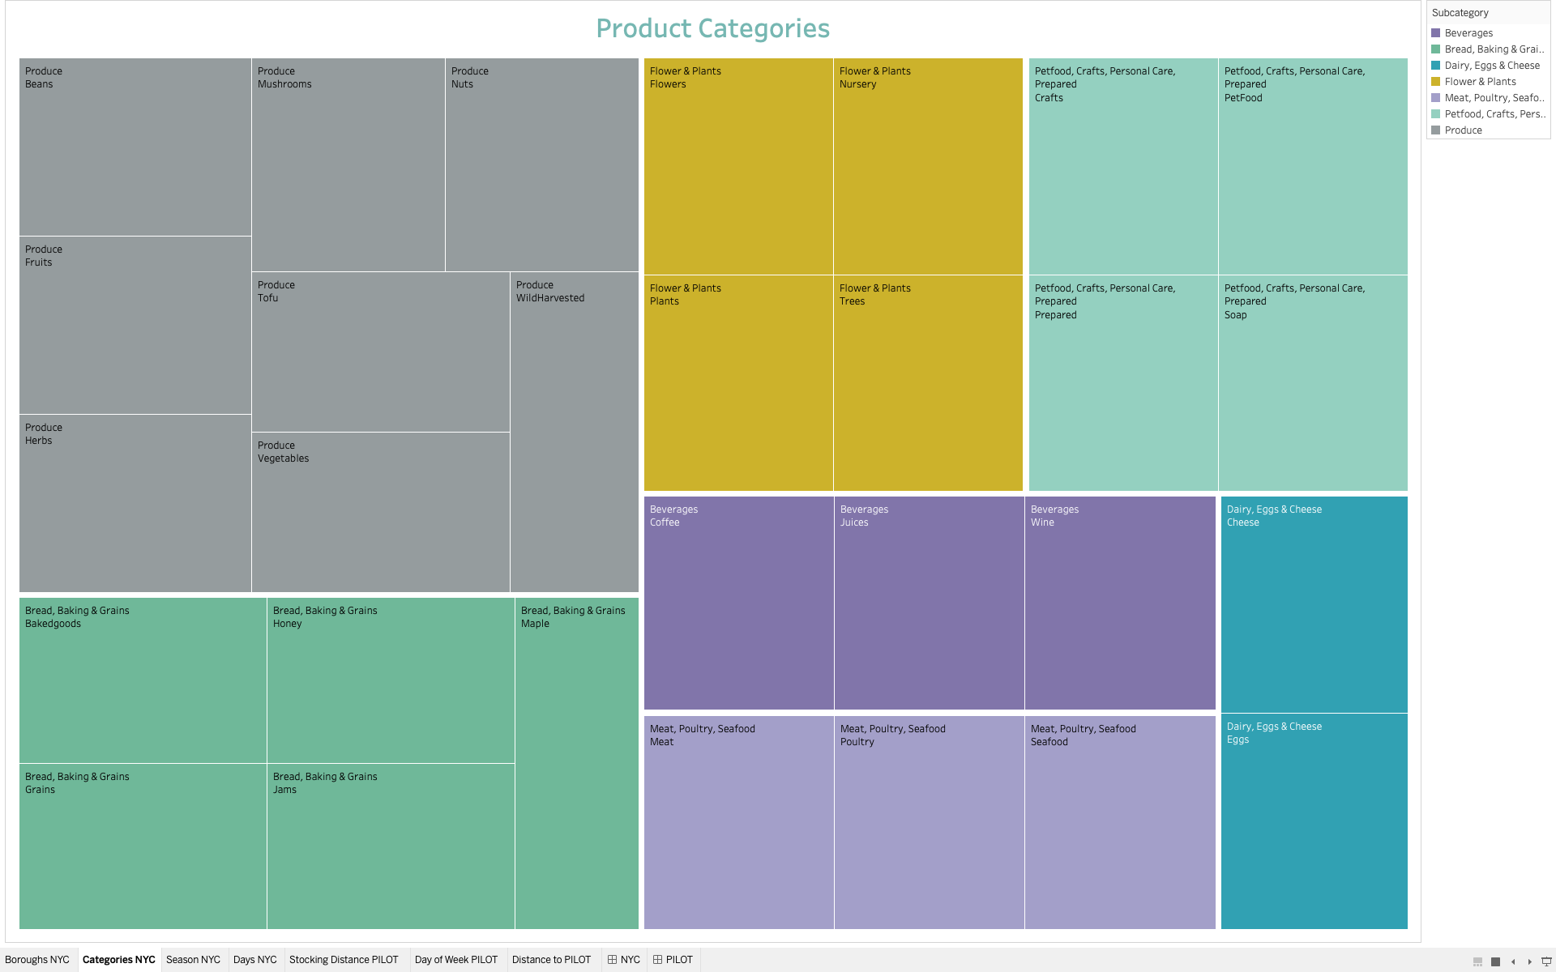
Product Categories

Slide 12
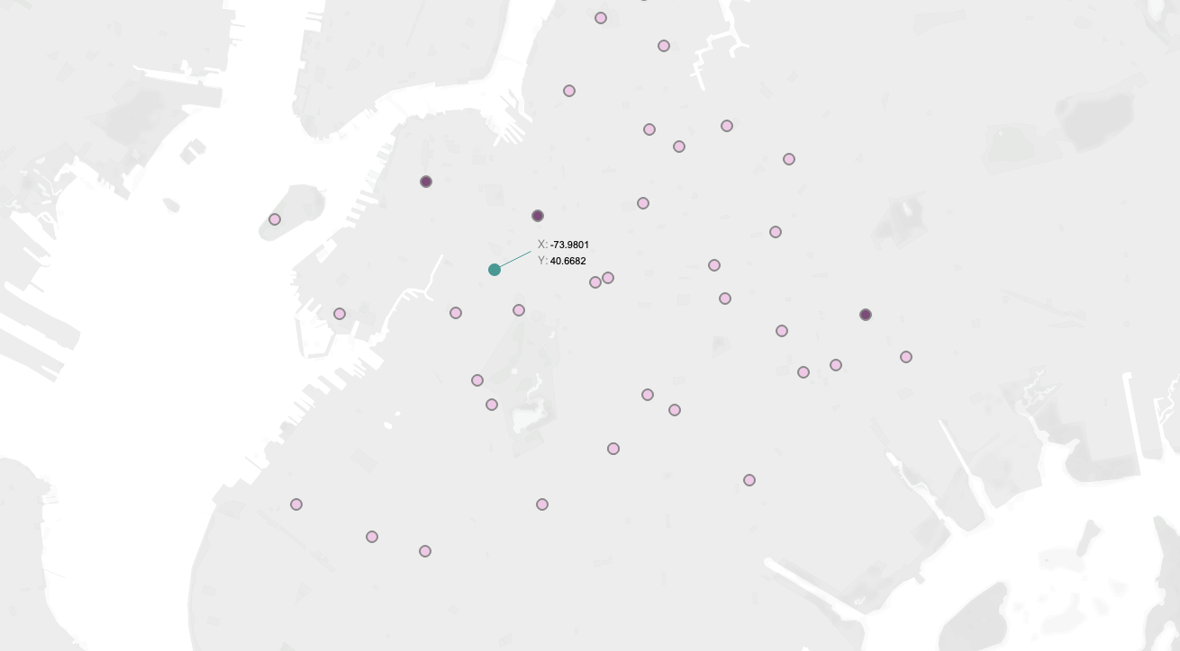
Tuesday Markets near pilot
Basics
Necessities
Good to Have
75%
50%
25%

Slide 13
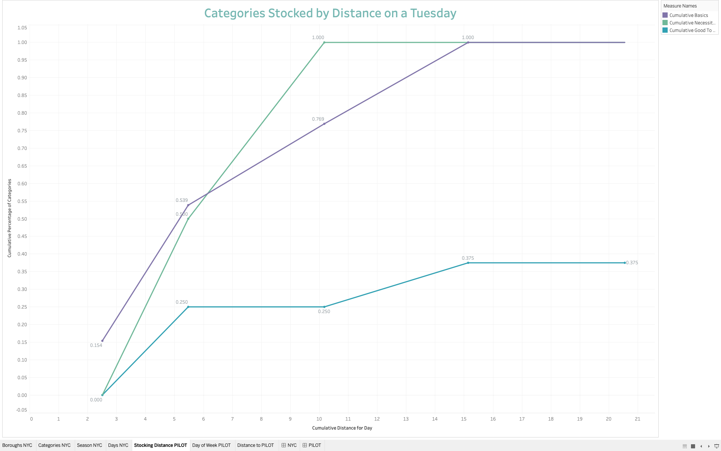
Categories stocked by Distance
on a Tuesday

Slide 14
TAKEAWAYS
%75
Under 20 km
1/7 days
Minimum
Basics Coverage
The most distance covered
Didn’t cover the Basics need
Ave. 10 km
Ave. 3 stops
Frequently
One day mileage
to achieve 75%
When it did cover
the Minimum
3rd or 4th stop

Slide 15
TAKEAWAYS
%50
Ave. 4.2 km
Ave. 2 Stops
Minimum
Necessities Coverage
One day mileage
to achieve 50%
1 Day, 5 Stops &
Coverage not achieved
%25
Ave. 0.25 km
Ave. 2 Stops
Minimum
Necessities Coverage
One day mileage
to achieve 25%
3 Days, 5 Stops &
Coverage not achieved

Slide 16
04
FUTURE WORK

Slide 17
OUR PLANS
Expand into other boroughs & diverse neighborhoods (Benefits Program) | Merge with DSNY Food Scrap Drop Off & GrowNYC (50 Food Access Locations) | Scale Statewide & to Other States with high FM Numbers
CITYWIDE | FOOD SCRAP PROGRAM | COUNTRYWIDE

Slide 18
05
APPENDIX

Slide 19
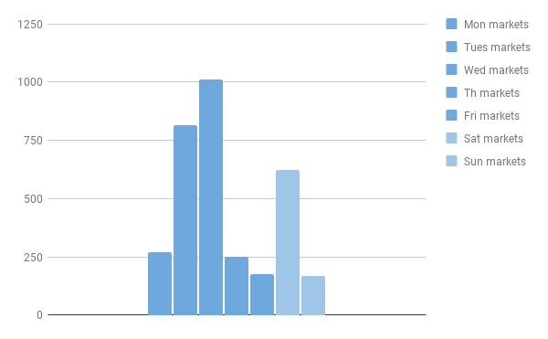
FREQ OF MARKETS
Contrary to belief, Sat & Sun not when most FM open
Also almost all are open only one season

Slide 20
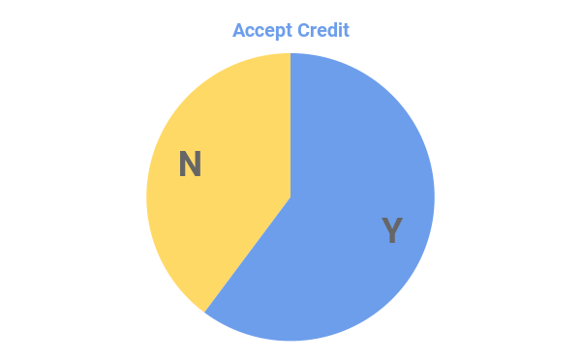
ACCESSIBILITY
Do they accept credit cards

Slide 21
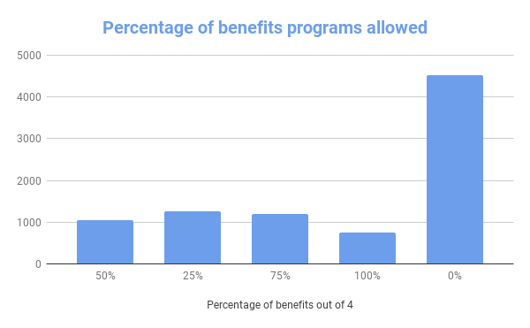
AFFORDABILITY
How many of the 4 major US benefits programs do they use

Slide 22
AFFORDABILITY
How many of the 4 major US benefits programs do they use

Slide 23
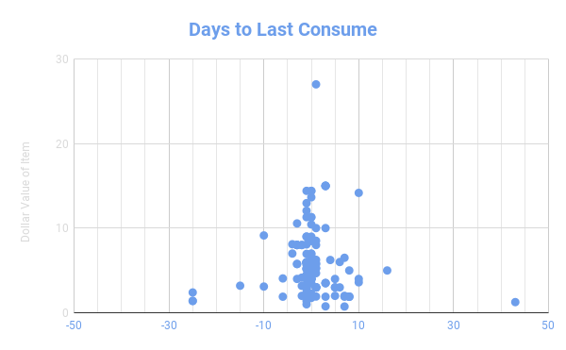
BROOKLYN FOOD SCRAPS DATABASE

Slide 24
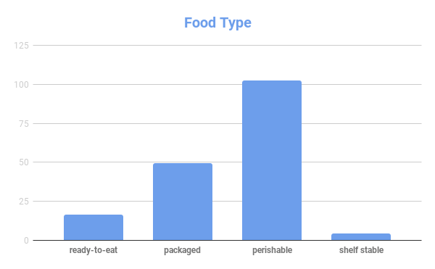
BROOKLYN FOOD SCRAPS DATABASE

Slide 25
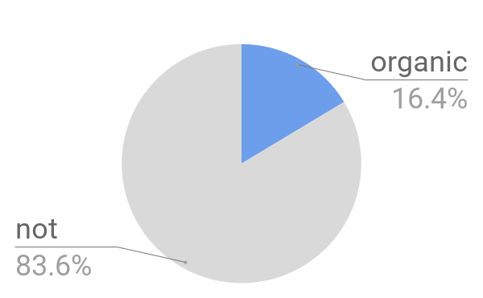
BROOKLYN FOOD SCRAPS DATABASE

Slide 26
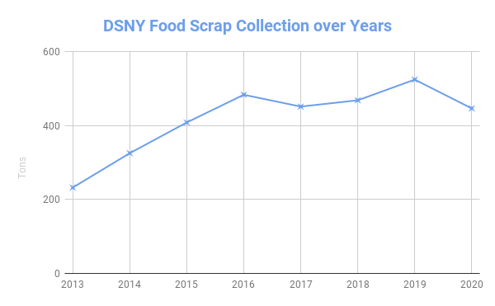
DSNY FOOD SCRAP PICK UP
BY TONNAGE

Slide 27
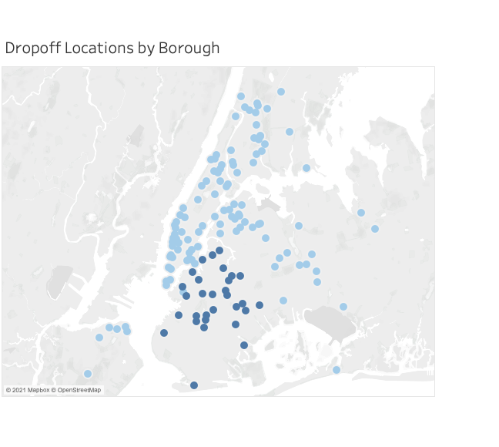
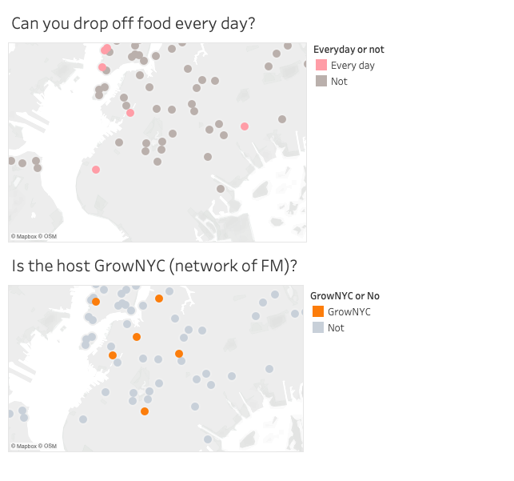
DSNY FOOD SCRAP
COLLECTION LOCATIONS

